Slide 1
Bell Work: Take 15ish minutes to finish up what you weren’t able to get to last time….
Working in groups of 1 – 3 people (everyone needs their own paper) work through the following:
Pg 116 #1, 3, 5, 11 (what assumption do we need to make?), 15, 17, 43, 44, 45, 47, 49, 53, 56, 58, 63, 71, 72, 75, 79, 81, 86, 89, 137, 162
Remember, ODD, answers are in the back. Check your work!

Slide 2
Pre-calc trig
Day 7

Slide 3
Objective
Identify main concepts from the review that we want to take notes on before our first unit test
Create our Review/Unit 1 Notes
Take Quiz

Slide 4
What do we need to review? Note: this will dictate how in depth we need to go with notes for our first test… as well as prepare us for our quiz

Slide 5
What do we need to review? Note: this will dictate how in depth we need to go with notes for our first test… as well as prepare us for our quiz A1: Story problems, linear equations (slope intercept, point slope, etc) and their graphs, functions f(x) and g(x)

Slide 6

Pre-Calc/Trig Quiz 1 Level 2: Evaluate
$1.) { (−2)}^{12}$
$2. ) \frac{5−2∙3+3^{2}}{4}$
$$3. ) 6\sqrt{25}÷{(9}^{2}−6)$$
4.) How can you identify the x and y intercept of any equation without using a graphing calculator.

Slide 7
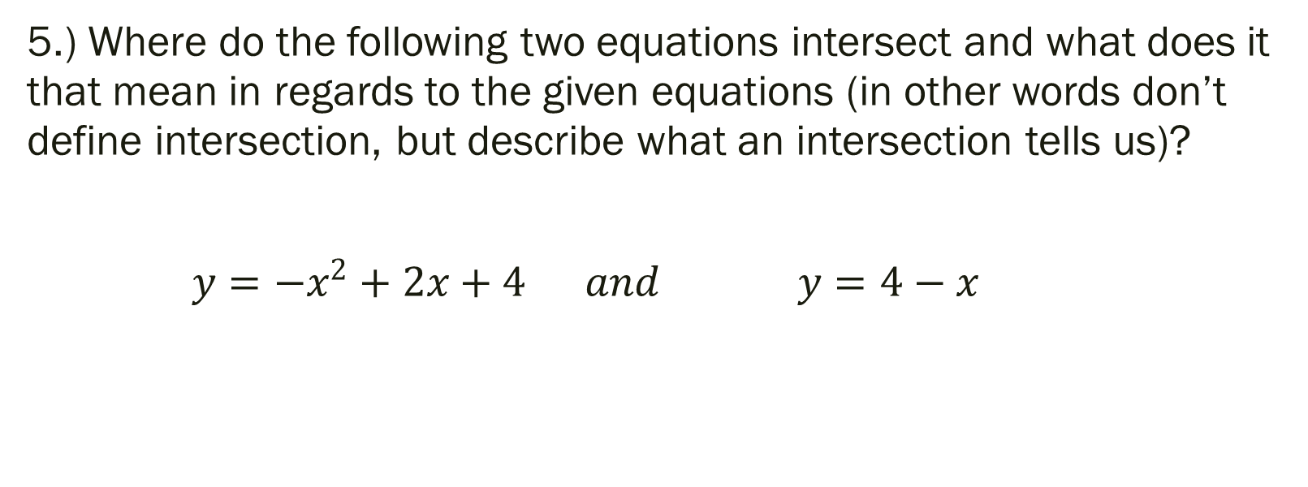
Pre-Calc/Trig Quiz 1 Level 3: Answer the following
5.) Where do the following two equations intersect and what does it that mean in regards to the given equations (in other words don’t define intersection, but describe what an intersection tells us)?
$y={−x}^{2}+2x+4 and y=4−x$

Slide 8
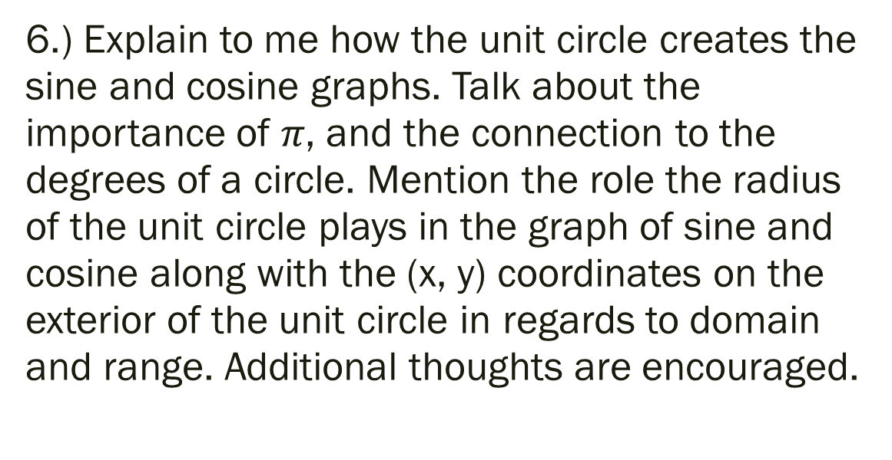
Pre-Calc/Trig Quiz 1 Level 4
6.) Explain to me how the unit circle creates the sine and cosine graphs. Talk about the importance of $π$, and the connection to the degrees of a circle. Mention the role the radius of the unit circle plays in the graph of sine and cosine along with the (x, y) coordinates on the exterior of the unit circle in regards to domain and range. Additional thoughts are encouraged.

Slide 9
Exit Ticket
On a scrap of paper describe how you felt you did on the quiz today, and explain what you intend to do differently in the future, or what you plan to continue to do going forward to prepare for this class.

